Slide 1
k nearest neighbors

Slide 2
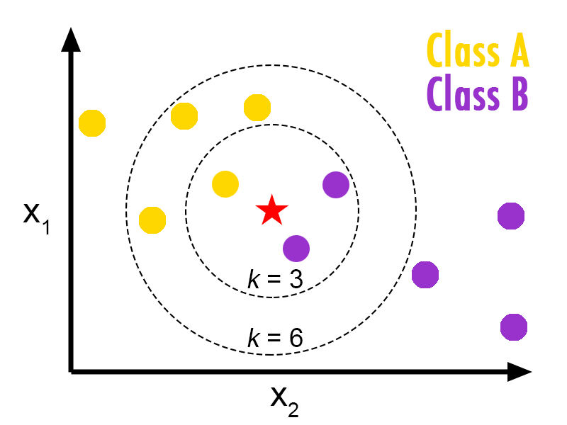
Introduction
An object is classified by a majority vote of its neighbors.

Slide 3
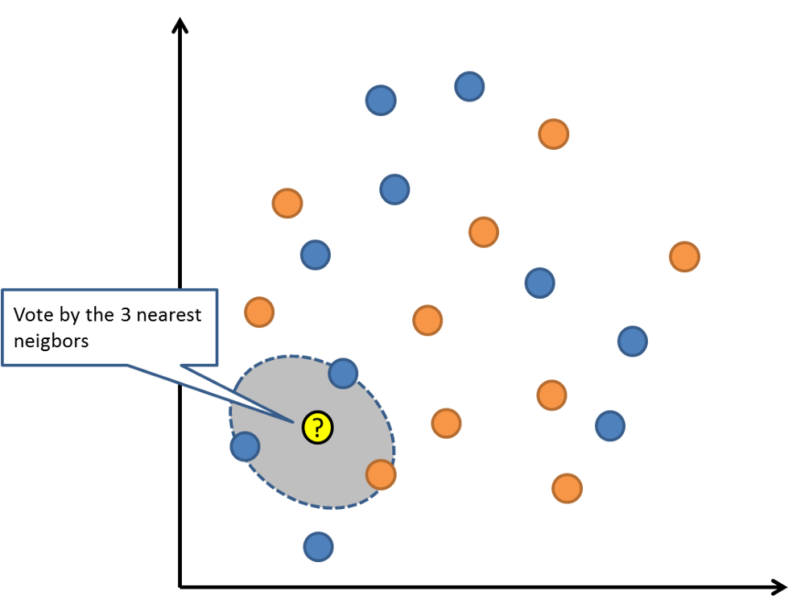
Introduction

Slide 4
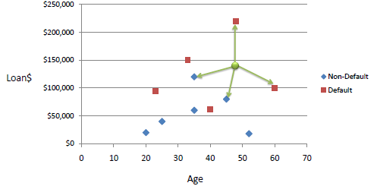
Data concerning credit default

Slide 5
k-Nearest-Neighbors
It is essentially classification by finding the most similar data points in the training data, and
making an educated guess based on their classifications.
In KNN, we must be able to keep the entire training set in memory.
Performing classifications can be computationally expensive as the algorithm parse through all data points for each classification.
For these reasons, kNN tends to work best on smaller data-sets that do not have many features.

Slide 6
How does the KNN algorithm work?
In KNN, K is the number of nearest neighbors.
Suppose P1 is the point, for which label needs to predict.
First, you find the k closest point to P1 and then classify point by majority vote of its k neighbors.
Each object votes for their class and the class with the most votes is taken as the prediction.
For finding closest similar points, you find the distance between points.

Slide 7
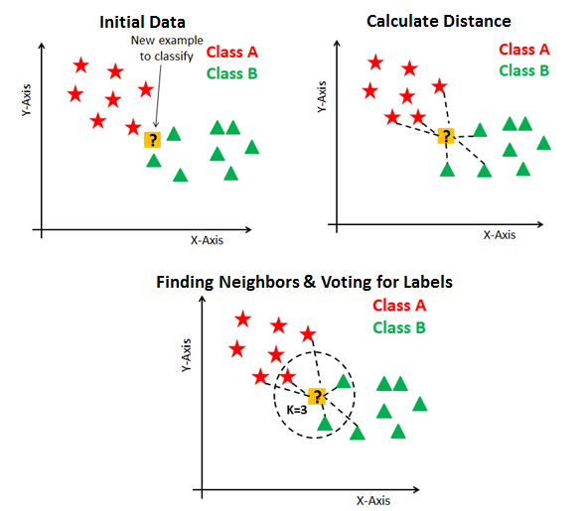
How does the KNN algorithm work?

Slide 8
K Nearest Neighbours — Pseudocode
1. Load the training and test data
2. Choose the value of K
3. For each point in test data:
- find the distance to all training data points
- store the distances in a list and sort it
- choose the first k points
- assign a class to the test point based on the majority of classes present in the chosen points
4. End

Slide 9
Thanks

